Slide 1
EE 295
TechWriting-Engineering Ethics
Sep 19, 2019
Room E339
Tom Wrappe
EE Lecturer

Slide 2
Agenda
Ch 4: Premodern Engineering : The Person
Electrical Engineering Premodern to Contemporary
Foresight: Blockchain Gadget Paper
Midterm Paper Assignment and Discussion
Topic Submission
Abstract and Summary Outline
Research Deliverable
Draft and Final
Upcoming items
Issue 9.24.19
Extra Credit for In Class Assignments

Slide 3
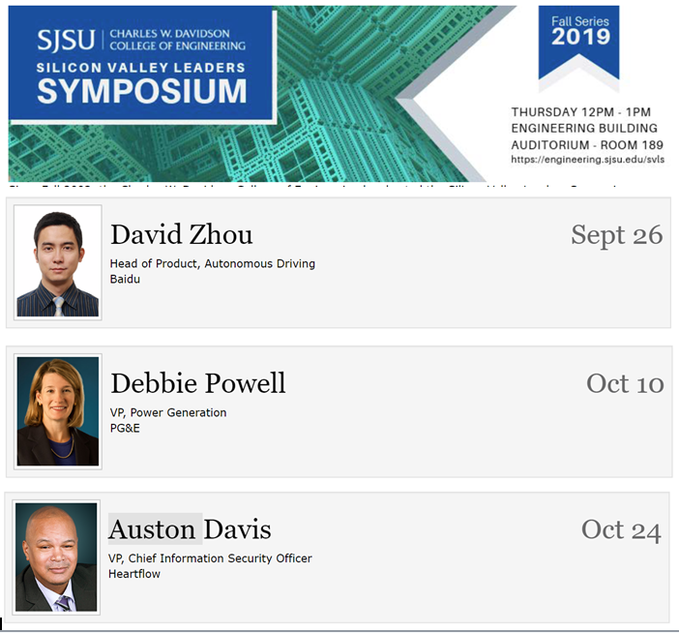
Extra Credit Opportunity: Attend Silicon Valley Leaders Symposium
https://engineering.sjsu.edu/our-college/events/silicon-valley-leaders-symposium

Slide 4
Lecturer Speaking Engagement Sep 23, 2019
Makeup Class Options for team (to be finalized by EE dept):
Choices---
-4:30 pm Wed, Oct 2
-6:00 pm Wed, Oct 2
-7:30 pm Wed, Oct 2
To be clear, Class will be Tu (Oct 1), W (Oct 2), and Thu (Oct 3) during week of Sep 30

Slide 5
Fair Warning
-In Class writing exercise within next two weeks
-Will be at BEGINNING of class with 30 min allowed INCLUDING Instructions (which begin promptly at 4:30pm or 7:30pm)
-Attend your own section unless granted permission at least 24 hours in advance

Slide 6
Ch 4: Person Evolution of Engineering
PreModern
Contemporary
Focal

Slide 7
Contrast of PreModern and Contemporary Engineering
Premodern |  | Contemporary
Practicality “Make it work for this need” | Brooklyn Bridge | Pragmatism “Make it work for many needs” | Standards for Telecom, UL, etc
Effectiveness “ Get the job done in the immediate case” | Local Electric Power | Efficiency “Get the job done in optimal fashion” | Solar Power Evolution
Fruitfulness “Focus on a single entity” | Early Automobiles | Productivity “Create a multitude of entities” | Evolving Wireless Services

Slide 8
PreModern Electrical Engineer
-Scientific focus
-Regional/National focus
-Inventor
+Alexander Graham Bell
+Edison
+Tesla
-Team with Entrepreneur
-Projects
+NYC electrification
+Niagara Falls Hydro
+Nationwide telegraph
+Telegraph
-Ethics Issues exist, but diluted in invention
+AC/DC Current : Edison electrocutions
+Pony Express obsolescence
https://www.youtube.com/watch?v=mNdtAY-W5qw

Slide 9
Contemporary Engineer
Global Perspective
Team Player
Multiplexing Skills
Communication and Computer Capabilities
Domain Skills
Disciplined
Dedicated
Serious
Rational
Curious
Industrious
Creative
Ethics are mainstream for society given pervasive nature of tech
Health issues of RF devices?
Alternate energy vs fossil fuels based on environmental impact
Artificial Intelligence impacting multiple professions and jobs

Slide 10
Video: Electrical Engineering

Slide 11
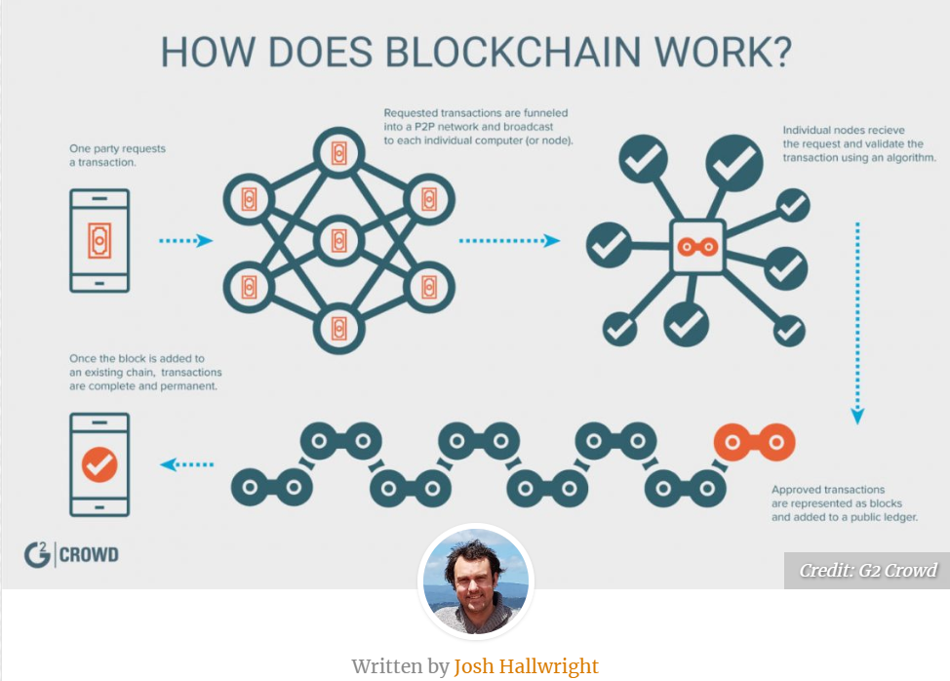

Slide 12
Tech Description: Blockchain
General Tech Description | Blockchain Related Items
Intro -Specific object -Quick background -General description of function, cause, effect -Overview of the contents | Blockchain is a secure ledger technology that provides foundation for multiple advanced services
Background
Discussion of parts/characteristics
Discuss Related operation
Conclusion | Blockchain is a technology that underlies safe and useful products

Slide 13
Writing Insight for Blockchain: Avoid the Offenders
Rank | Issue | Description | Example | Action
1 | Filler | Interesting, but distracting narrative beyond the focus of the exercise | -Peripheral Historic facts -Focus on applications when description is the assignment | -Focus on the purpose of the document and limit filler to a transition role either for the beginning or between elements
2 | Passive Voice | -non active statements | -”Blockchain was applied to Bitcoin by Satoshi Nakamoto” | -Review and convert all sentences to active “Satoshi Nakamoto wrote the Bitcoin whitepaper based on Blockchain.”
3 | Pronouns | No “it, I , they” | “Blockchain is a secure ledger technology. It underlies Bitcoin and other valuable services” | “ Blockchain is a secure ledger technology that underlies Bitcoin and other valuable services”
4 | Proper verbs | Choose a time reference and stick to it in all verbs | “Several cryptocurrencies were using Blockchain in 2015” | Reference is real time and is in the past –”used” is past. Go with “Cryptocurrencies used Blockchain..” Also avoid “are using”—”use”

Slide 14
Do not Forget Self Grading Sheet
As a condition of grading, supply the following (on a “Self Grading Report” page following the assignment)
Example:
Self Grading Sheet for Gadget Exercise
a. Word count
b. Underline or highlight the topic sentence of each paragraph in the paper (Done)
c. Provide your check of the EE295 key elements by filling out and including certification of 1. No personal pronouns, 2. No use of passive voice, 3. no use of "very", 4. All paragraphs complete and at least 3 sentences. Provide a table with these four rows and a column noting your compliance to each
Item | Description | Status
1 | Word Count | xxx
2 | Underline all topic sentences | Checked
3 | No personal pronouns | Checked
4 | No passive voice sentences | Checked
5 | No use of “very” | Checked
6 | All paragraphs w at least 3 sentences | Checked

Slide 15
Semester Major Items…..(subject to modification)
 | Mid Term | Resume | Final Paper | Final Presentation (slides )
Topic Paragraph | 9.5.19
Topic Proposed | 9.12.19 |  | 10.3.19
Topic Final | 9.19.19 |  | 10.10.19
Outline/ Abstract | 9.26.19 |  | 10.31.19
Research | 10.1.19 | 10.24.19 (Class) | 10.15.19
Draft Complete | 10.10.19 |  | 11.7.19 | 11.19.19
Final Submit | 10.22.19 | 11.14.19 | 11.26.19 | 12.3.19
Final Presentation | NA | NA | NA | 12.17.19 (Sect 1) 12.12.19 (Sect 2)

Slide 16
A Progressive Process
Step | Due | Notes
Discuss a topic | 9.5.19 | 1 paragraph on end product (Bring to Class)
Propose a topic/ company | 9.12.19 | 600 words overview of the paper (Turnin)
Abstract/Outline | 9.26.19 | Skeleton of the paper
Research Deliverable | 10.1.19 | Support Element
Draft | 10.10.19 | Complete paper, but needing edit
Final Submission | 10.22.19 | Final product

Slide 17
Midterm: First 5 Page Report
The First 5 Page Report will be a Proposal/Business Plan focused on adding a new product to the product line or entering a new area
-Target audience is “your boss” who wants to get the project approved
-Arm her/him with the convincing approach and supporting facts to get the project moving
-Topic areas suggested, but specific paper topic should be put forth by the student
Submit candidate topic writeup (600 words) for approval
Develop interim deliverables per schedule
Scheduled final submission is Mar 19

Slide 18
Present Midterm Status
1. Proposed Topic for Business Proposal (Submitted)
Industry Area (ie, semi, networking, …)
Company (chosen existing company or newco)
Product area (no need to be specific just yet)
Why you chose the topic and why you thing it is a good one
2. Abstract and (Expanded) Outline of the Midterm Paper (Due Sep 26)
3. Be thinking about the research on market, company, technology that is needed (final citations due Oct 1)
4. How will you budget your 5-6 pages between the outline sections?

Slide 19
Midterm-Related Abstract/Expanded Outline
Submit an abstract and a summary outline of the 5-page Midterm Business Proposal
1. Expand on your topic selection
-”Fine tune” your topic
-Create an outline based on the 8 sections of the example (Abstract, Exec Summary, etc....). The Proposed Product is…/The Product is safe and useful because……
2. Prepare one or two full paragraphs (not bullet items, full sentence-based paragraphs) that capture the key elements of each section. UNDERLINE THE TOPIC SENTENCE OF EACH PARAGRAPH.
Begin your market and technology research
-Identify at least 3 market sources for your market research
-Identify at least 2 potential product/technology competitors to your proposed product
3. Provide a “budget” totaling 2800-3000 words –not including the references section--for your “5 Page” Midterm paper (How will you spend your budget on each section of the outline?)
4. Attach Self-Grading Sheet: 1. Grammar checklist
As always, 15% plagiarism or less is required from Turnitin

Slide 20
A Concise Version of a Business Plan
(1) Abstract
(2) The Executive Summary
(3) The Proposed Business Concept
(4) Research and Analysis
-Market Analysis: How large is the market for this product?
-Competitive Analysis: How this product compares to others in area
(5) Finance and Economics
(6) Management Team
(7) Summary of Risks and Assumptions
(8) Conclusions and Recommendations

Slide 21
First 5 page Proposal A Concise Version of a Business Plan
Outline | Outline/ Abstract | Draft (5 pages) | Midterm paper (5 pages) | Final Paper ? 15 pages
1. Abstract | Paragraph | ½ page max | ½ page max
2. Executive Summary | paragraph | ½ to 1 page | ½ to 1 page
3. Product Description/ Business Concept | 2 paragraphs or so | 1-3 pages
4. Research and Analysis | 1-2 paragraphs (5 sources min) | 1-3 pages | Depends on sources
5. Finance and Economics | 1 paragraph | ½ to 1 page
6. Management Team | 1 paragraph | ½ page
7. Risks and Assumptions | List of items | ½ page
8. Conclusions and Recommendations | 1-2 sentences | ¼ to ½ page
Sources | Not Applicable | ½ to 1 page | ½ to 1 page
The outline endures while the content grows

Slide 22
Midterm-Research Assignment:
More is better, but begin your research on Market and Product:
-Identify at least 3 market sources for your market research
-Identify at least 2 potential product/technology competitors to your proposed product and contrast them with your product
Utilize IEEE Format (Guidelines supplied in Canvas-Modules )
As always, 15% plagiarism or less is required from Turnitin (quote your sources in IEEE format.
(http://sites.ieee.org/pcs/transactions-of-professional-communication/for-prospective-authors/guidelines-to-follow/guidelines-for-preparing-references/)

Slide 23
Good Abstracts and Executive Summaries
EE 295
Tom Wrappe
EE Lecturer

Slide 24
Overview
The Abstract and the Executive Summary are your “first impressions” to your key audiences
Technical persons “searching” via Abstracts
Executives who need to understand quickly the gist of your idea
Both Abstracts and Executives Summaries should be your best writing
Concise and clear
Short , but good flow
100% correct grammar, spelling and punctuation

Slide 25
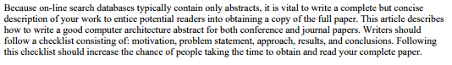
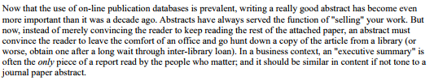
How to Write an Abstract Philip Koopman, Carnegie Mellon Oct, 1997
Abstract for an Abstract
Introduction

Slide 26
Abstract Checklist
Despite the fact that an abstract is quite brief, it must do almost as much work as the multi-page paper that follows it.
In a computer architecture paper, this means that it should in most cases include the following sections.
Each section is typically a single sentence, although there is room for creativity. In particular, the parts may be merged or spread among a set of sentences. Use the following as a checklist for your next abstract:
Motivation
Problem Statement
Approach
Results
Conclusions

Slide 27
Parts of an Abstract
Motivation
Why do we care to make this paper?
Goes first if the problem is NOT OBVIOUS, otherwise Problem Statement first
Problem Statement
What problem are you trying to solve?
What is the scope of your paper—specific solution (Product) or a general study of a tech area (Research)
Approach
How did you go about solving or making progress on the problem?
What was the extent of your work?
How far did you go to explore the options
Results
What was your answer?
How was your approach better than other potential approaches?
Faster, Cheaper, smaller, more precise?
Go for concise answers rather than vagueness
Conclusions
What are the implications of your answer?
Is it going to change the world, be a nice hack or simply serve that this approach is not the way to go?
Are your results applicable only to your issue or across a large spectrum of problems/ opportunities

Slide 28
Other Considerations on Abstracts
Abstract limit of 150 to 200 words is typical
Any major restrictions of the subject technology or product should be stated
Avoid noncommittal words like “could”, “might”, “may” (you should be definitive on your approach)
Include at least a half dozen search words and phrases

Slide 29
Conclusion on Abstracts
A Well-written abstract sets up your paper for success since it is a personal marketing engine that allows all with an internet engine to find your work
To write a final, concise abstract requires a lot of work and is best accomplished after the body of the paper is done.

Slide 30
Autonomous Vehicle Navigation
ABSTRACT— (Motivation) Autonomous vehicle navigation has gained increasing importance in various growing application areas. In this paper we describe a system that navigates the vehicle autonomously to its destination. (Problem Statement) In non-urban Domains such as open deserts, the problem of successful GPS-based navigation appears to be almost solved while navigation in urban domains, particularly in the close vicinity of buildings, is still a challenging problem. In such situations GPS accuracy significantly drops down due to unavailability of GPS signal. (Approach) This system provides a communication between vehicle and internet using a GPRS modem. This system is interfaced with OSRM open source map through internet. (Results) This project improves the efficiency in navigation by using location information from inertial sensors to complement GPS signals. This system also uses a rotatable laser range finder for improved obstacle sensing. (Summary) The autonomous vehicle navigation system has broad applications for self driving vehicles.
KEYWORDS— GPS, GPRS, compass, navigation, localization, inertial, laser

Slide 31
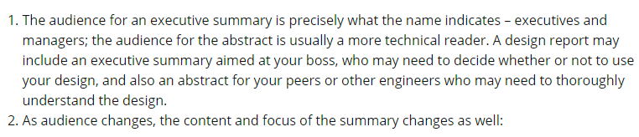
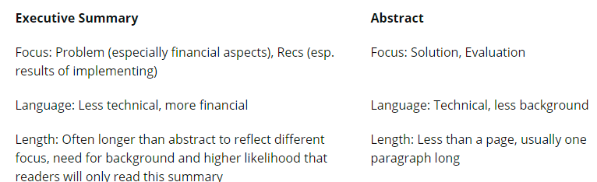
Executive Summary vs Abstract Audience Matters

Slide 32
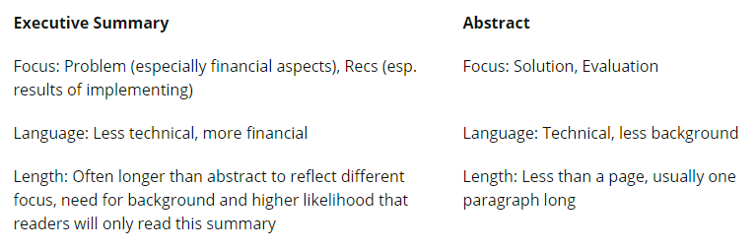

Slide 33
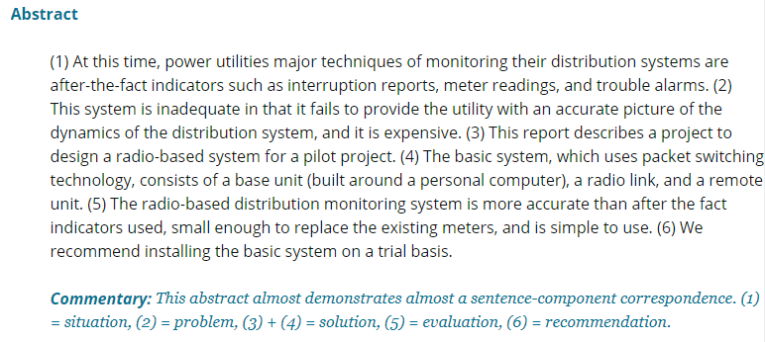
Example –Power Distribution Monitoring

Slide 34
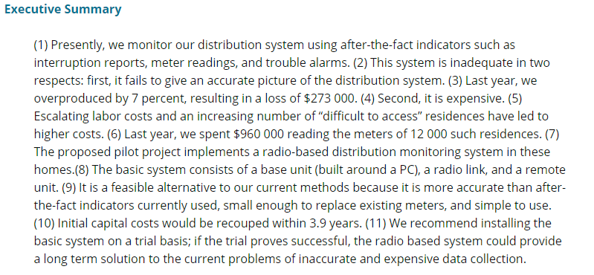
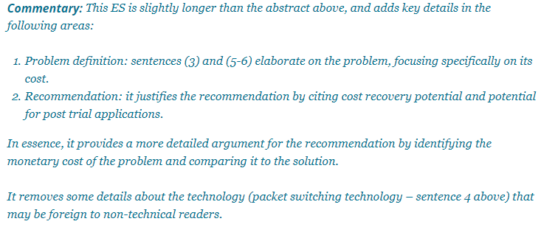
Example –Power Distribution Monitoring

Slide 35
Citing in IEEE per IEEE Style Guide
http://sites.ieee.org/pcs/transactions-of-professional-communication/for-prospective-authors/guidelines-to-follow/guidelines-for-preparing-references/

Slide 36
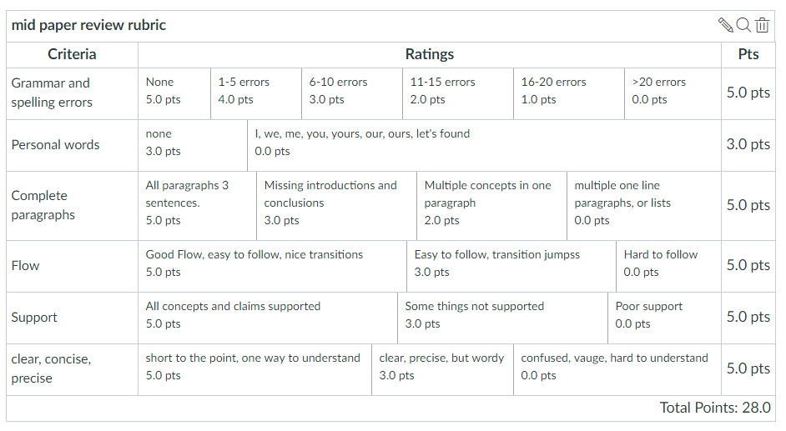
Midterm Paper Rubric

